Slide 1
BU DRIVERS DASHBORD

Slide 2
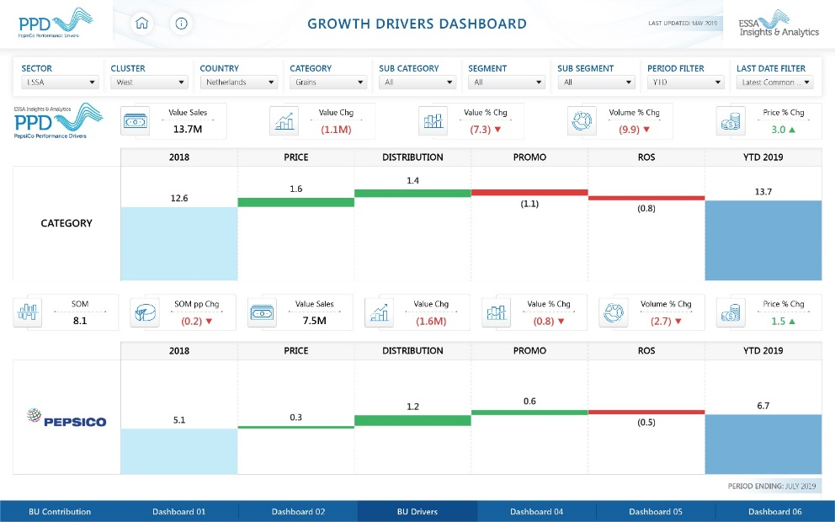
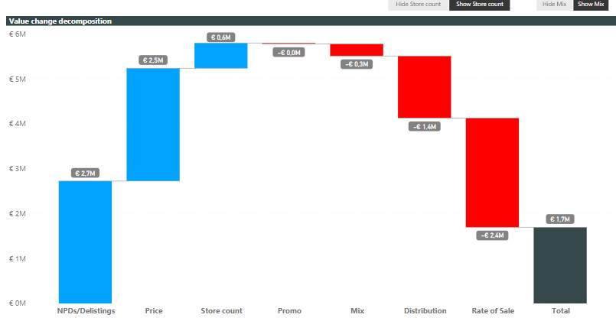
Dashboard Design Template
Aggregate Period Views (FY, MAT, YTD, QTD, LP ) or Trended
Visuals Proposed:
Filters list:
Drivers KPI’s
Category
(Total)
Cluster & BU – Category level Drivers
Channel
Time period
Manufacturer Filter
Brand (?)
Segment
Trade
Channel
Cluster & BU – Int. Trade Channel level Drivers
Segment + Sub Segment
Cluster & BU – Segment & Sub-Segment level Drivers
Manuf.
Cluster & BU – Manufacturer level Drivers
Brand + Sub Brand mix
Cluster & BU – Brand + Sub Brand level Drivers
Comments:
Option to choose distribution measure (this should also change the ROS metric accordingly)
TDPs
Absolute Distribution
Is it possible to split distribution contribution into depth (number of SKUs vs breadth (distribution)
Option to add contribution from change in number of stores? Or add like-for-like universe option
Option to compare two manufacturers, manufacturer and category, two segments, two brands,
Option to include or exclude promo contribution
Option to separate Price into Mix / Weight change
Weight change vs Inners change (e.g. Multipacks)
Key Flavour / Item
Cluster & BU – Flavour / Item level Drivers
Key Flavour / Item
Trade Channel x Segment
Int Trade Channel by Segment level Drivers
Key Flavour / Item
Trade Channel x Manuf. / Brand
Int Trade Channel by Manuf. / Brand level Drivers
Key Flavour / Item
Segment by Manuf. / Brand
Segment by Manuf. / Brand level Volumetrics
Drivers
Key Flavour / Item

Slide 3
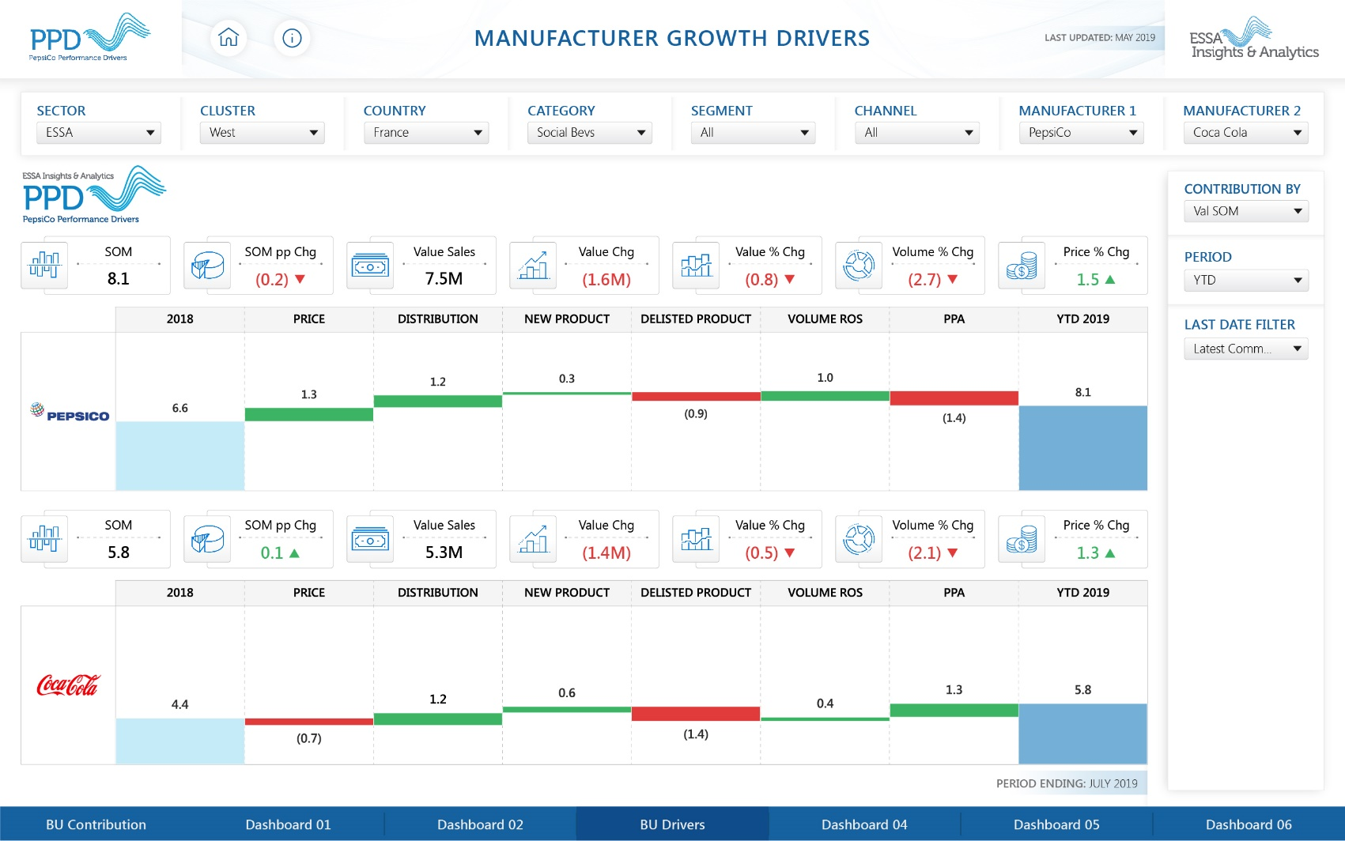
MANUFACTURER GROWTH DRIVERS
NOTES:

Slide 4
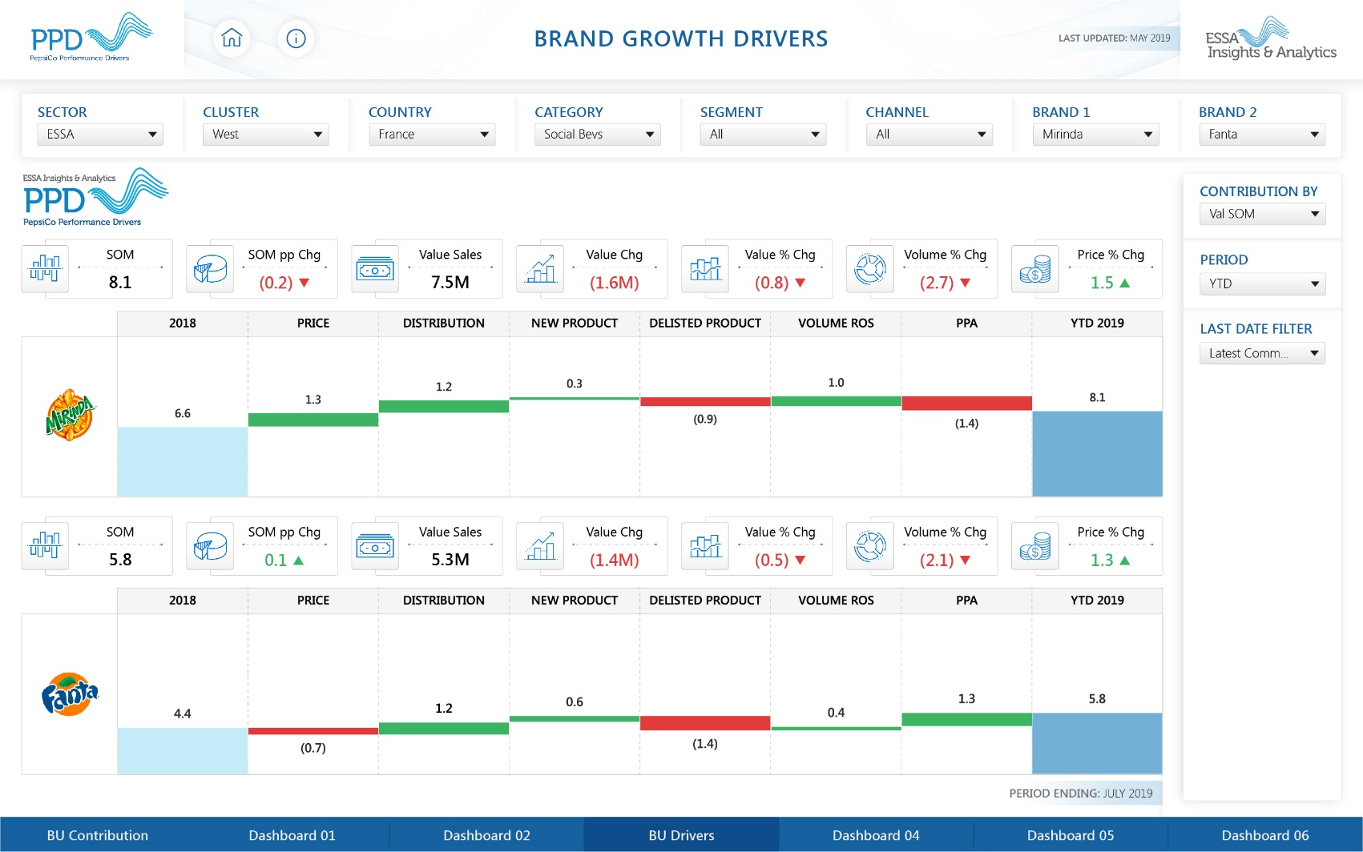
BRAND GROWTH DRIVERS
NOTES:

Slide 5
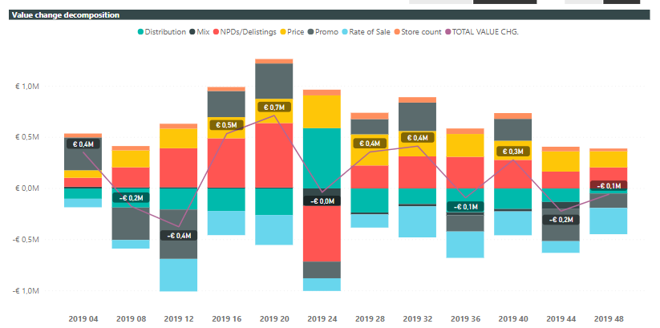
Dashboard Design Template
Aggregate Period Views (FY, MAT, YTD, QTD, LP ) or Trended
Visuals Proposed:
Filters list:
Drivers KPI’s
Category
(Total)
Cluster & BU – Category level Drivers
Channel
Time period
Manufacturer Filter
Brand (?)
Segment
Trade
Channel
Cluster & BU – Int. Trade Channel level Drivers
Segment + Sub Segment
Cluster & BU – Segment & Sub-Segment level Drivers
Manuf.
Cluster & BU – Manufacturer level Drivers
Brand + Sub Brand mix
Cluster & BU – Brand + Sub Brand level Drivers
Comments:
Trended chart with the drivers
Key Flavour / Item
Cluster & BU – Flavour / Item level Drivers
Key Flavour / Item
Trade Channel x Segment
Int Trade Channel by Segment level Drivers
Key Flavour / Item
Trade Channel x Manuf. / Brand
Int Trade Channel by Manuf. / Brand level Drivers
Key Flavour / Item
Segment by Manuf. / Brand
Segment by Manuf. / Brand level Volumetrics
Drivers
Key Flavour / Item

Slide 6
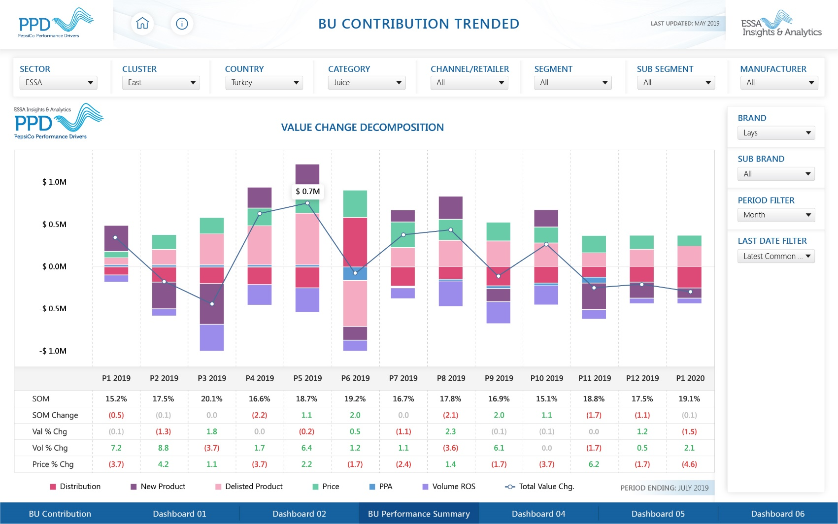
BU CONTRIBUTION TRENDED
NOTES:
Include “All” under manufacturer for Total category view
Period filter – Month, Qtr, Year

Slide 7
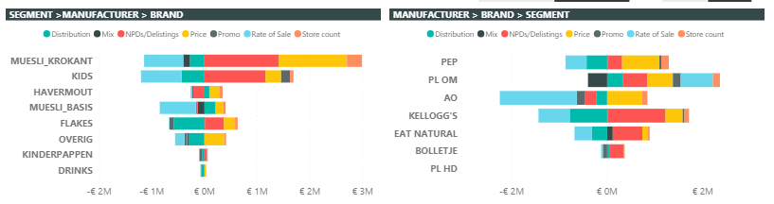
Dashboard Design Template
Aggregate Period Views (FY, MAT, YTD, QTD, LP ) or Trended
Visuals Proposed:
Filters list:
Drivers KPI’s
Category
(Total)
Cluster & BU – Category level Drivers
Channel
Time period
Manufacturer Filter
Brand (?)
Segment
Trade
Channel
Cluster & BU – Int. Trade Channel level Drivers
Segment + Sub Segment
Cluster & BU – Segment & Sub-Segment level Drivers
Manuf.
Cluster & BU – Manufacturer level Drivers
Brand + Sub Brand mix
Cluster & BU – Brand + Sub Brand level Drivers
Comments:
Drivers by segment and by manufacturer
Key Flavour / Item
Cluster & BU – Flavour / Item level Drivers
Key Flavour / Item
Trade Channel x Segment
Int Trade Channel by Segment level Drivers
Key Flavour / Item
Trade Channel x Manuf. / Brand
Int Trade Channel by Manuf. / Brand level Drivers
Key Flavour / Item
Segment by Manuf. / Brand
Segment by Manuf. / Brand level Volumetrics
Drivers
Key Flavour / Item

Slide 8
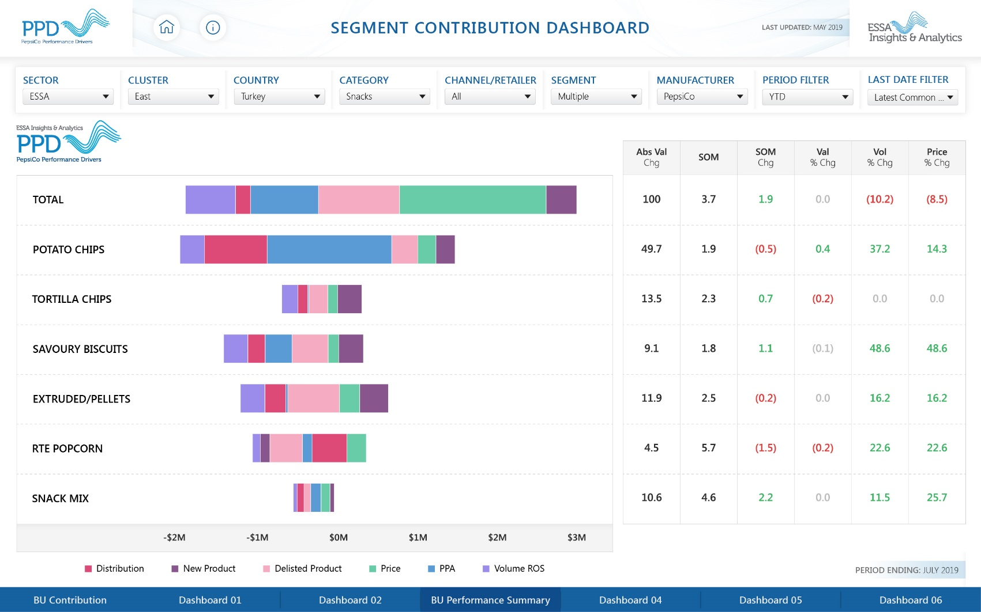
SEGMENT CONTRIBUTION DASHBOARD
NOTES:
Select segments to analyse (multi select)

Slide 9
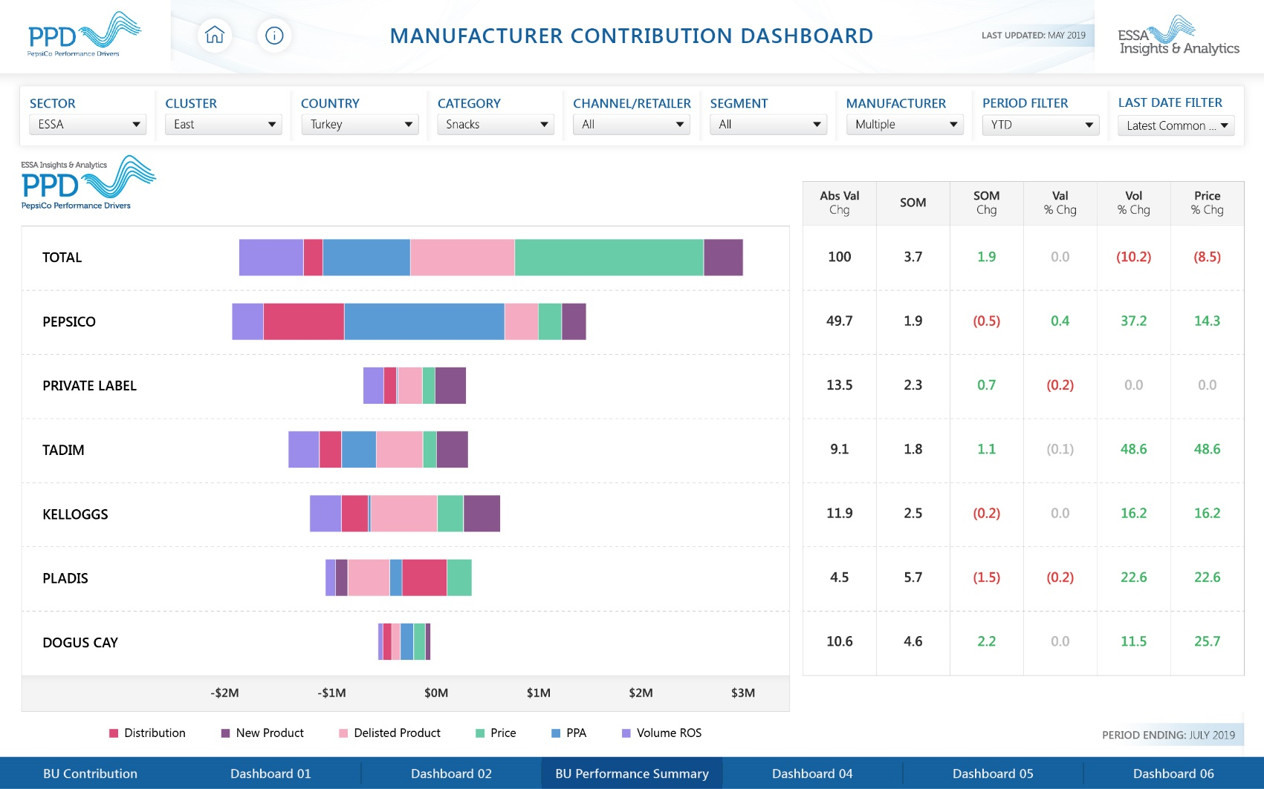
MANUFACTURER CONTRIBUTION DASHBOARD
NOTES:
Select manufacturers to analyse (multi select)
Can we limit to 10?
Can build brand drivers on similar lines

Slide 10
MANUFACTURER CONTRIBUTION DASHBOARD
BRAND
BRAND
NOTES:
Select manufacturers to analyse (multi select)
Can we limit to 10?
Can build brand drivers on similar lines
BRANDS

Slide 11
CATEGORY DRIVERS DASHBORD

Slide 12
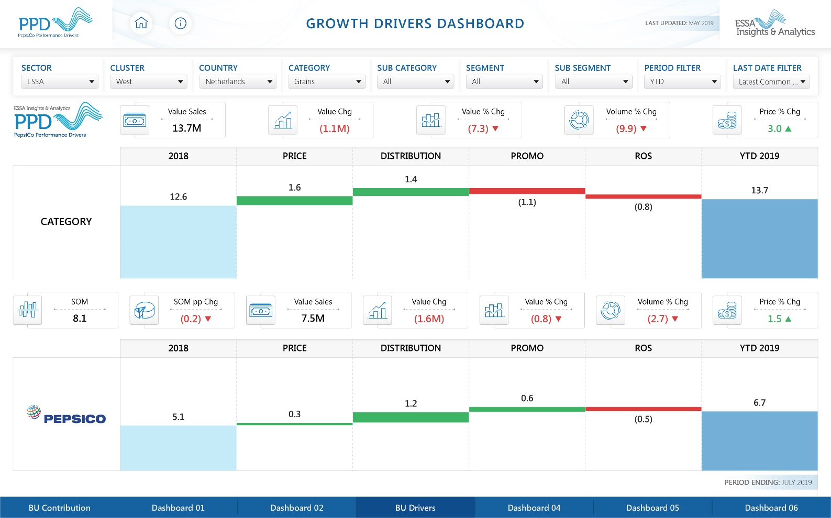
BU Growth Drivers
This view helps analyse the contribution to Abs Value change by different drivers – Price, Dist, Promo, ROS
The view presents a comparison between Category & PepsiCo
Analysis can be done for a Category, Sub Category, Segment or Brand
We definitely need this one in Cat part as well☺
Channel filter to be added
How to extract Promo effect especially for EE countries? Whats the approach for WE countries?
For Brands, Value SOM contribution option
As a driver, NPD and Delists to be added separately
PPA to be considered as a driver if possible

Slide 13
MANUFACTURER GROWTH DRIVERS
NOTES:
“All” manufacturer option for total category view
Contribution by – Val SOM, Vol SOM, Abs Val chg, Abs Vol change

Slide 14
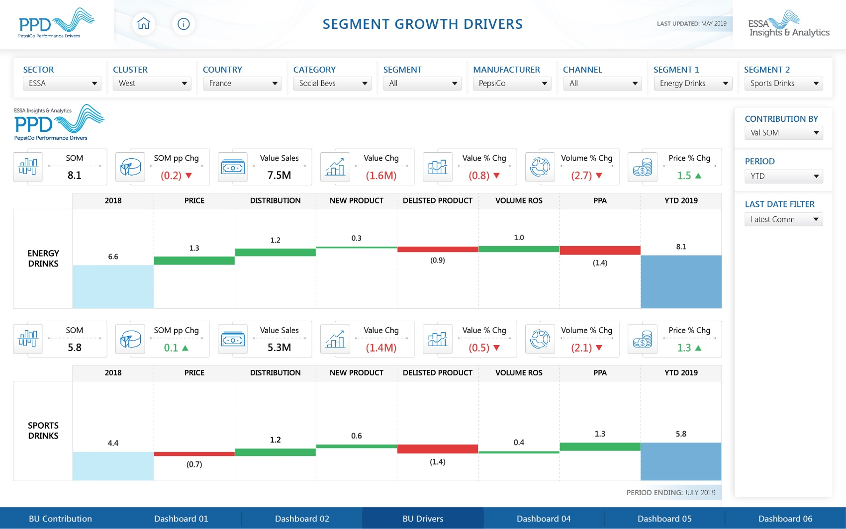
SEGMENT GROWTH DRIVERS
NOTES:
Contribution by – Val SOM, Vol SOM, Abs Val chg, Abs Vol change

